Slide 1
24CSA303 MOBILE APPLICATION DEVELOPMENT

Slide 2
Introduction to Android Studio
Android is a mobile operating system based on a modified version of the Linux kernel and other open source software, designed primarily for touchscreen mobile devices such as smartphones and tablets.

Slide 3

The Official IDE: Android Studio is the standard, Google-backed development environment built on JetBrains' IntelliJ IDEA (Integrated Development Environment Application).
software, Which offers a powerful code editor and developer tool.
Core Languages: Projects are primarily written using Kotlin or Java for logic, while XML is utilized to design the user interface (UI).
System Minimums: For stable presentation demonstrations, ensure devices have at least 4GB RAM (8GB+ recommended) and 2GB available disk space.
Notes:
Android was originally founded as a startup in 2003 by Andy Rubin, Rich Miner, Nick Sears, and Chris White. Initially intended as an operating system for digital cameras, the company pivoted to smartphones and was acquired by Google in 2005. The first commercial Android phone, the HTC Dream, was released in 2008

Slide 4
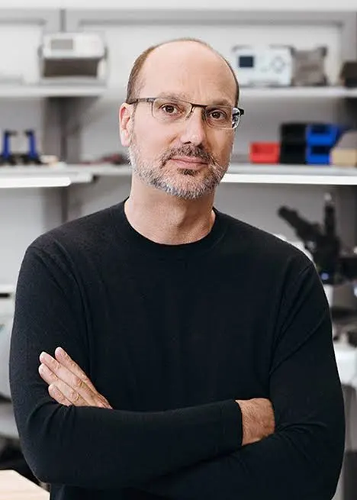

Notes:
The whole world is now obsessed and overwhelmed with the Android technology. The phenomenal tale of the man who made Android, Andy Rubin is definitely worth knowing. Rubin made Android happen to the world, post the twists and turns encountered while pitching it as the future of mobile technology. Andrew E. Rubin (born March 13, 1963) is an American computer programmer, entrepreneur, and venture capitalist. Rubin founded Danger Inc. in 1999 and left in 2003; Danger was eventually acquired by Microsoft in 2008. Rubin founded Android Inc. in 2003, which was acquired by Google in 2005. Andy Rubin worked at Apple from 1989 to 1992 as a manufacturing engineer.^{[7]} Rubin was nicknamed "Android" by his co-workers at Apple in 1989 due to a love of robots, with the nickname eventually becoming the official name of the Android operating system.

Slide 5
Andr……oid
The term android ultimately originates from the Greek words andr- (meaning "man" or "human") and -oid (meaning "resembling" or "like"). Together, the literal translation is "man-like" or "human-like"

Slide 6
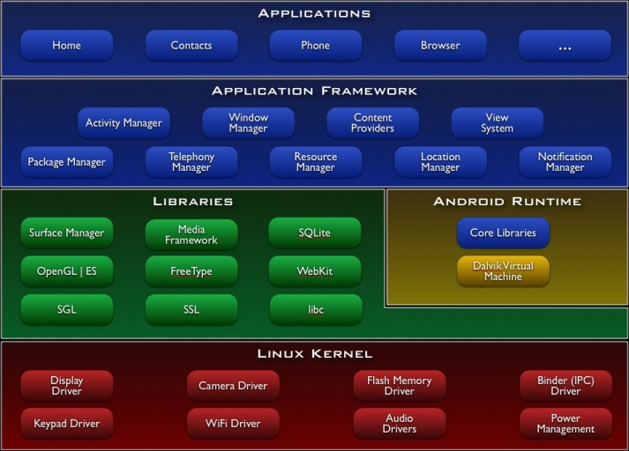
Android System Architecture

Slide 7
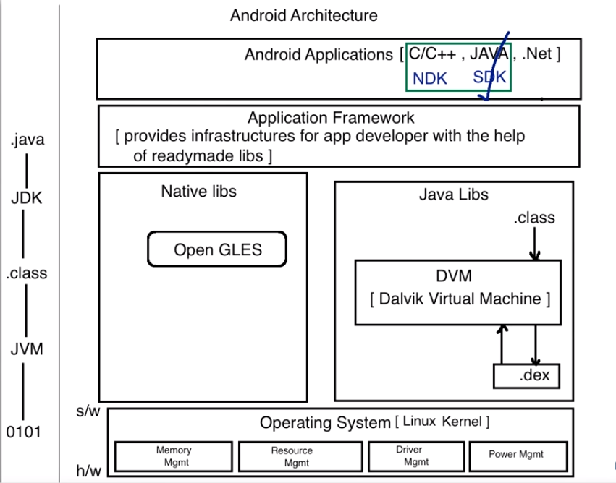

Slide 8
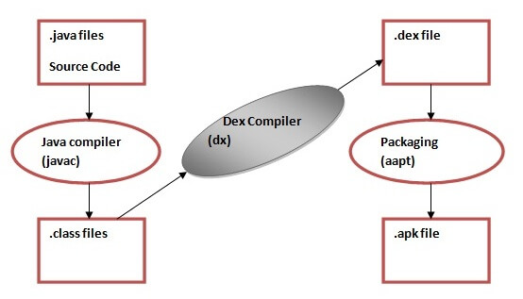

Slide 9
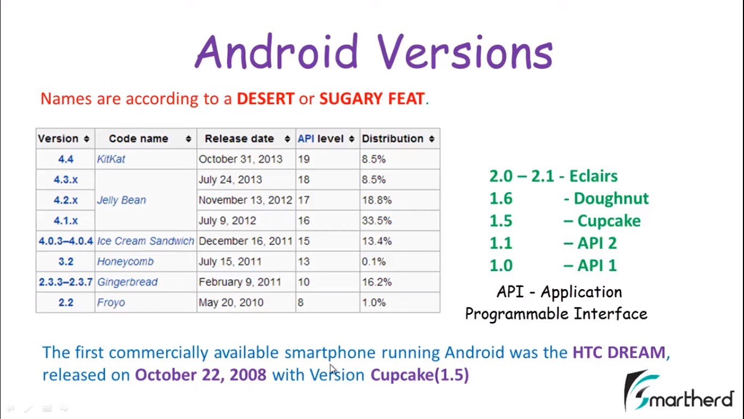

Slide 10
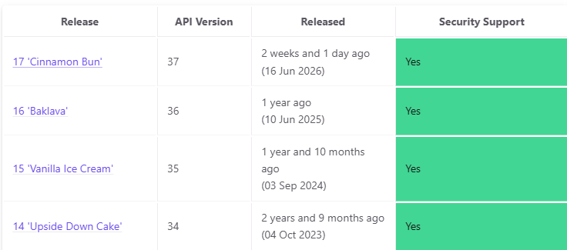
Recent Android Stable Version Timeline
Android Version | API Level | Release Date | Current Ecosystem Status
Android 17 | API 37 | June 16, 2026 | Latest Release: Mainline version for new flagship hardware.
Android 16 | API 36 | June 10, 2025 | Most Widely Used: Heavily active across consumer devices.
Android 15 | API 35 | September 3, 2024 | Legacy Stable: Broadly deployed on mid-range/older devices.

Slide 11
Key Developer Features in the Latest Stable Release
Advanced Multitasking: Implements system-wide floating "Bubbles" and desktop-style window orientation tools for tablets and foldable smartphones
Next-Gen Media Formats: Built-in compatibility for RAW14 image formats and custom vendor camera extension tools.
Eclipsa Video Standard: Natively processes HDR video streams while adapting dynamic lighting directly to real-world ambient environment sensors.
Granular Privacy Controls:: Features single-use temporary location boundaries and specialized security modules that lock hardware immediately if a theft pattern is detected

Slide 12
What This Means For Your Android Studio Project
Set your compileSdk to 37 to compile with the latest stable APIs.
Set your targetSdk to 37 to tell the operating system that your app is thoroughly tested for Android 17 behaviors.
Set your minSdk to 35 or 36 if you want to ensure your application can still run on the largest portion of devices globally without breaking legacy functionality.

Slide 13
The 4 Structural Pillars of Android Apps
Activities: The visual entry points representing a single user-interface screen.
Services: Background processes that run without providing a direct user interface.
Broadcast Receivers: Gateway elements that allow your app to respond to system-wide announcement signals.
Content Providers: Managed data structures used to safely share data between different apps

Slide 14
Essential Project File Architecture
app/manifests/AndroidManifest.xml: Every app must have this file at its root to declare permissions, activities, and fundamental components to the Android system.
app/java/: Houses the Kotlin or Java source code files (e.g., MainActivity.kt).
app/res/layout/: Contains the visual structural design files written in XML format.
Gradle Scripts: Automation build files that manage external plugins, project dependencies, and software versioning.

Slide 15
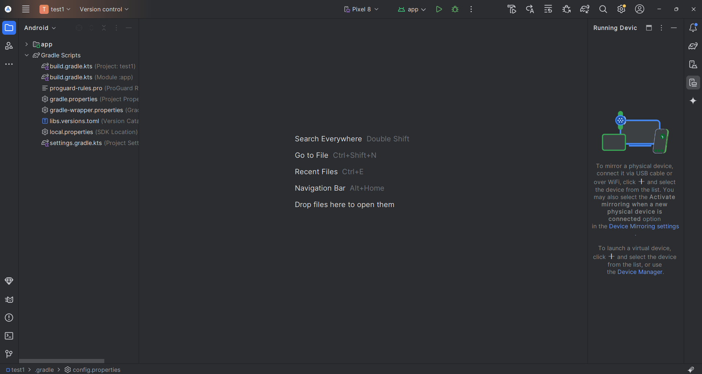

Slide 16
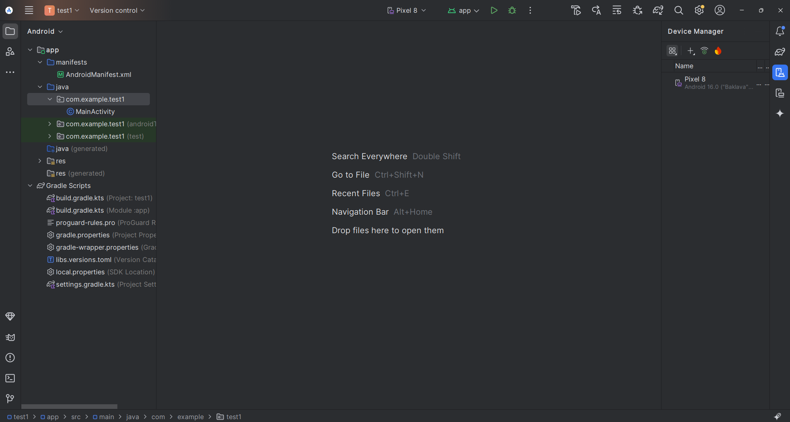

Slide 17
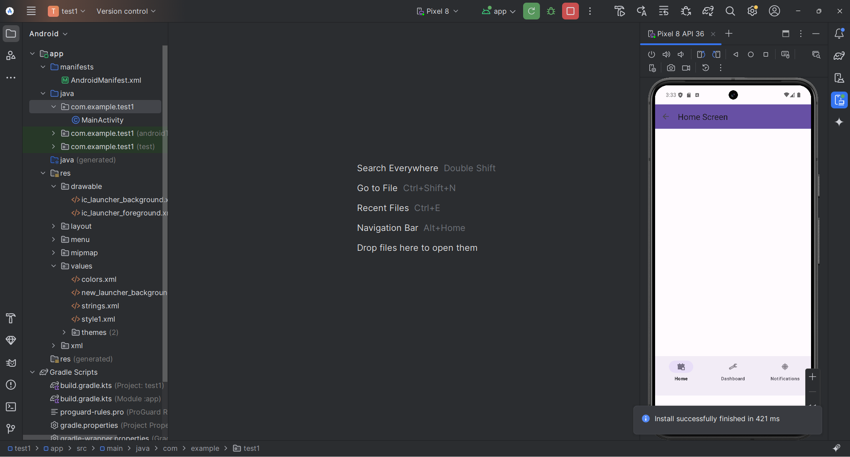

Slide 18
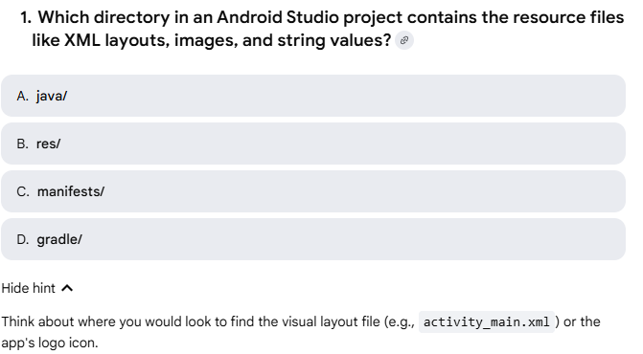
Questions…..

Slide 19
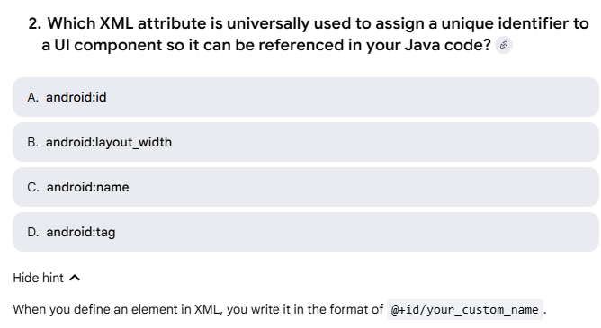

Slide 20
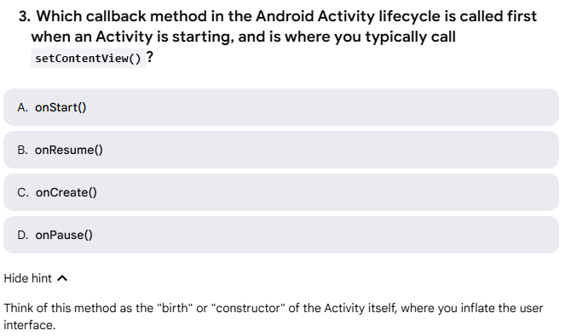

Slide 21
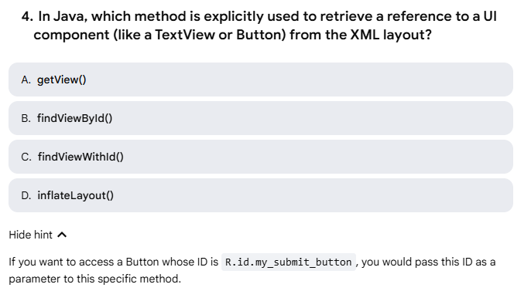

Slide 22
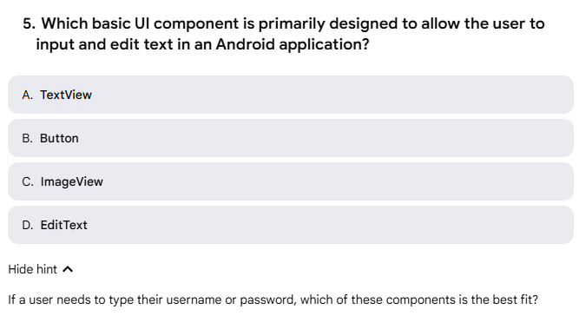

Slide 23
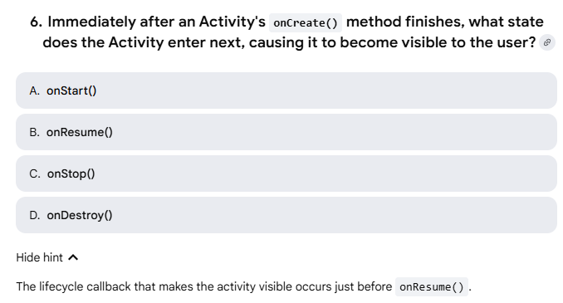

Slide 24
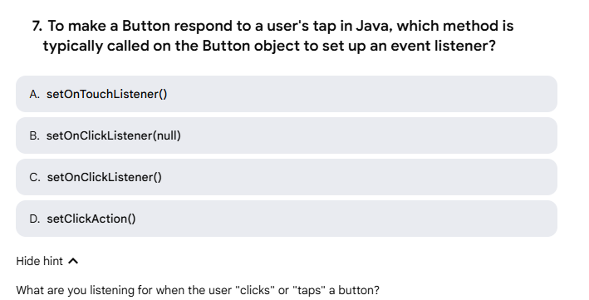

Slide 25
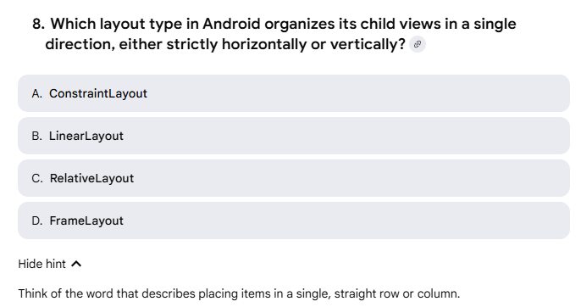

Slide 26
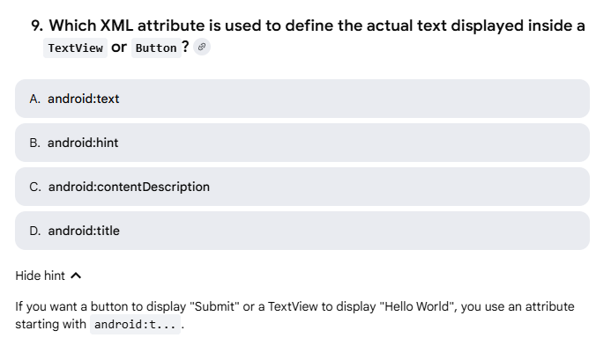

Slide 27
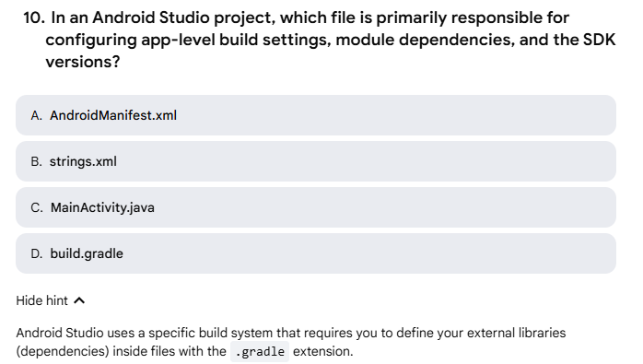

Slide 28
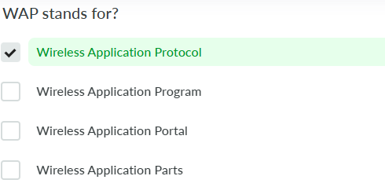
11.

Slide 29
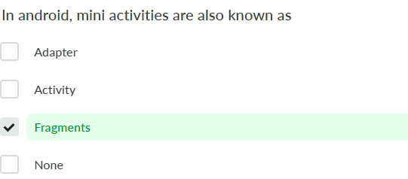
12

Slide 30
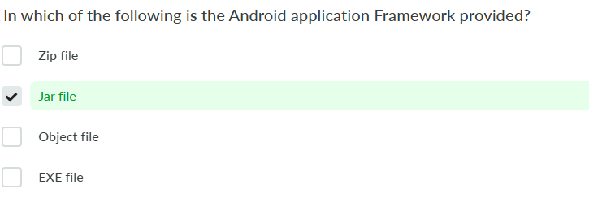
13

Slide 31
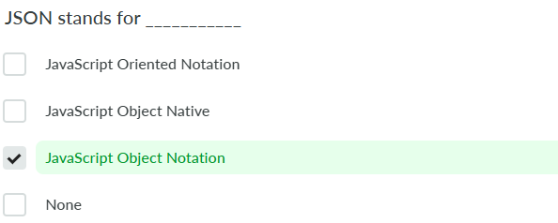
14

Slide 32
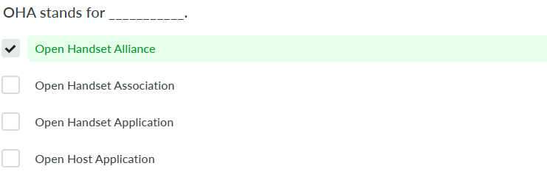
15

Slide 33
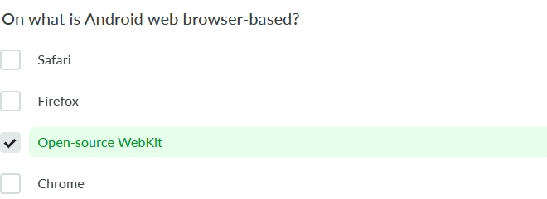
16

Slide 34
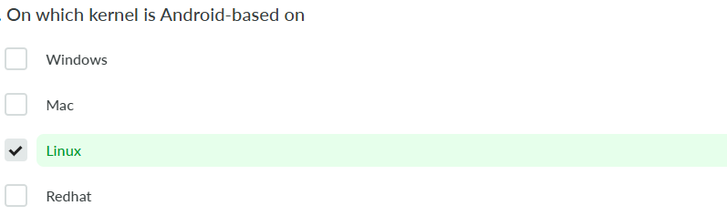
17

Slide 35
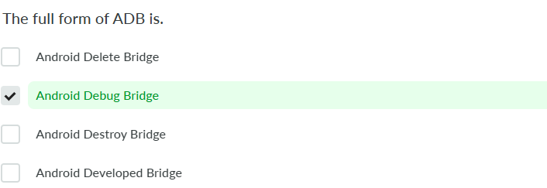
18

Slide 36
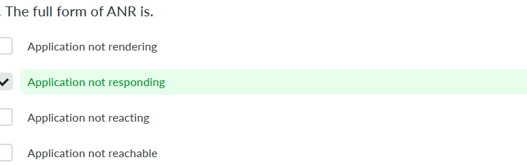
19

Slide 37
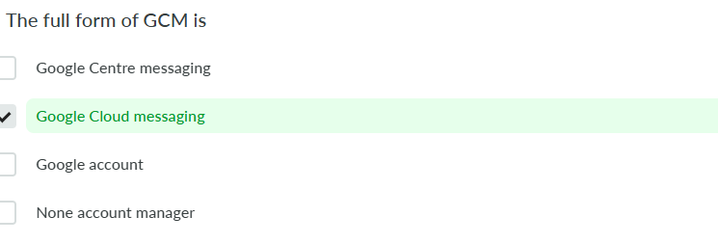
20

Slide 38
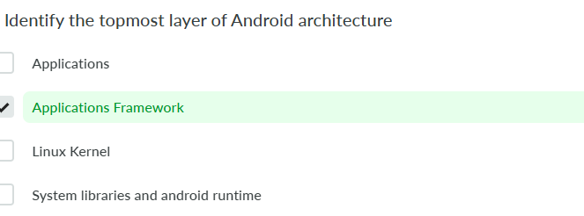
21

Slide 39
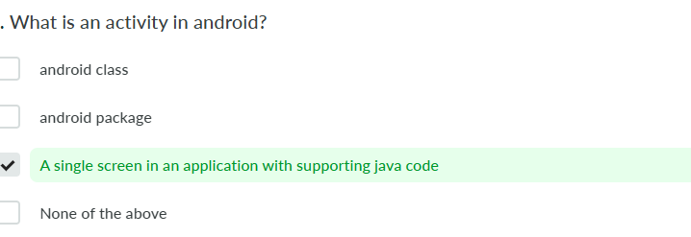
22

Slide 40
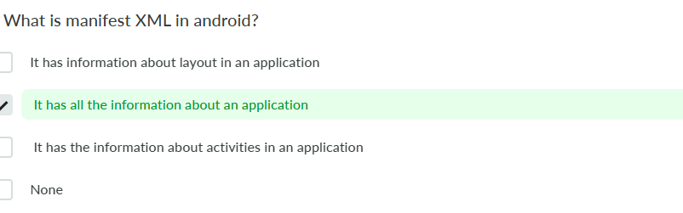
23

Slide 41
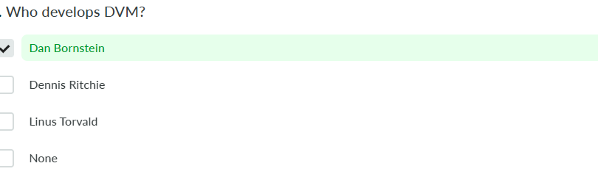
24

Slide 42
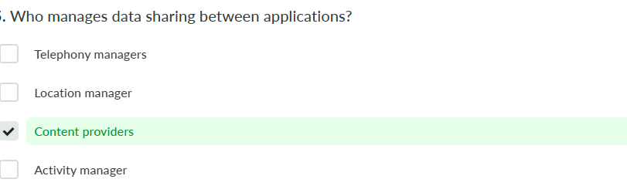
25

Slide 43
https://www.youtube.com/watch?v=JAsdcM0PPn4
https://developer.android.com/courses/android-basics-compose/course

Slide 44
Thank You

